Slide 1
Vector methods in Statistical NLP

Slide 2
Document vectors
Old idea in document retrieval --- Gerard Salton, 1960s
Bag of words view of documents.
A document is viewed as a vector in an enormous vector space: 1 dimension for every word in the language.
For document d, word w, d[w] is the “weight” of word w in document d.

Slide 3
Weight of word w in document d
0 if w is not in d.
If w is in d, various measures:
F(w,d) – the number of times w appears in d.
TF-IDF. Let C be the number of documents in the collection. Let Q(w) be the number of documents that contain word w.
Then d[w] = F(w,d) ∙ log(C/Q(w))
Puts more weight on rare words. If “mastodon” appears in a document, that tells you more than if “animal” does.
Other features: font, size, title, etc.

Slide 4
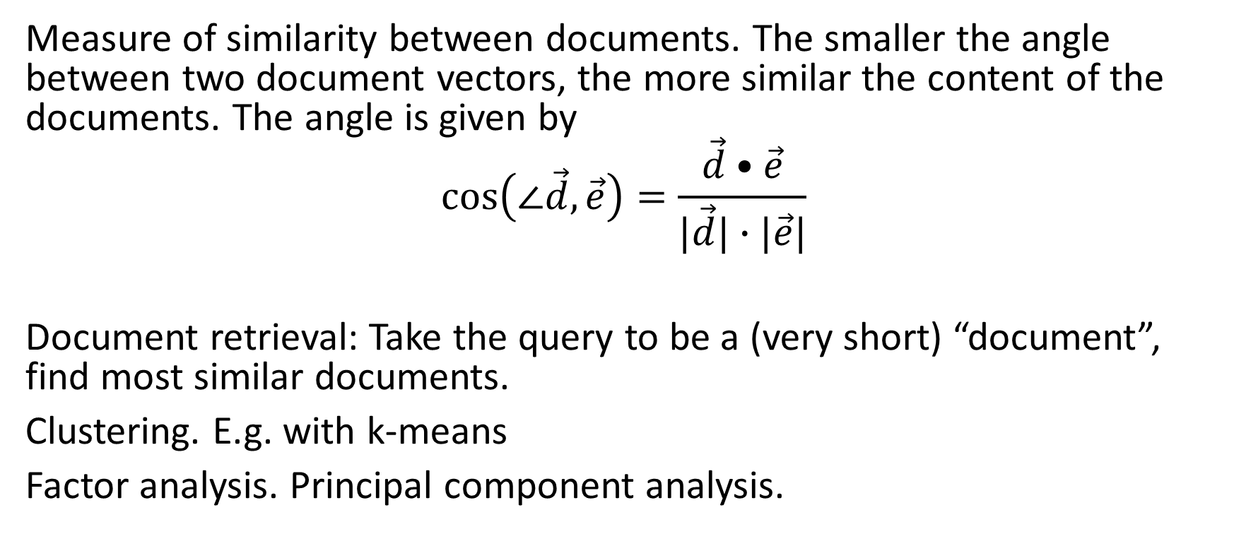
Uses of document vectors
Measure of similarity between documents. The smaller the angle between two document vectors, the more similar the content of the documents. The angle is given by
$$\cos\left(∠\vec{d},\vec{e}\right)=\frac{\vec{d}•\vec{e}}{|\vec{d}|∙|\vec{e}|}$$
Document retrieval: Take the query to be a (very short) “document”, find most similar documents.
Clustering. E.g. with k-means
Factor analysis. Principal component analysis.

Slide 5
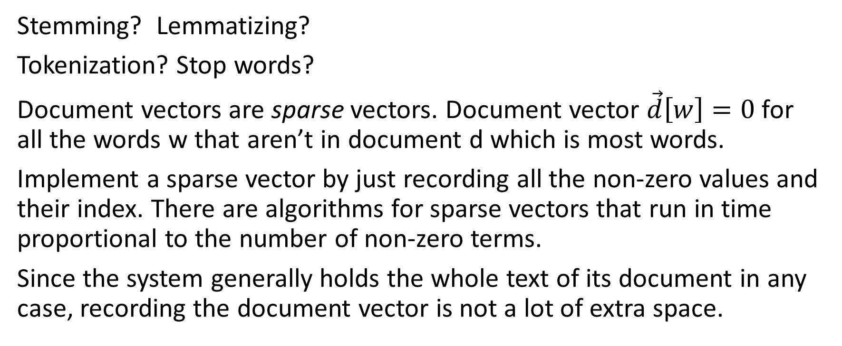
What is a word, for this purpose?
Stemming? Lemmatizing?
Tokenization? Stop words?
Document vectors are sparse vectors. Document vector $\vec{d}\left[w\right]=0$ for all the words w that aren’t in document d which is most words.
Implement a sparse vector by just recording all the non-zero values and their index. There are algorithms for sparse vectors that run in time proportional to the number of non-zero terms.
Since the system generally holds the whole text of its document in any case, recording the document vector is not a lot of extra space.

Slide 6
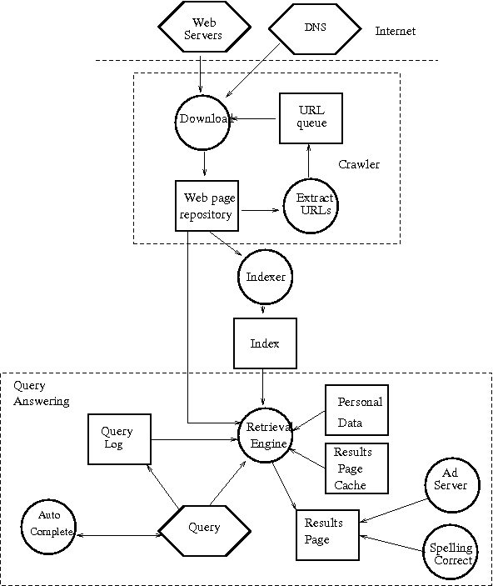

Slide 9
Web search engines Query-specific features
Does the text contain words that match the query? Matching may involve synonyms; or stemming; or spelling correction (in either query or document); or other relation.
Click-through information. How often have users who posed this query clicked on this page? (Note: Google queries follow a Zipf distribution; a very large fraction f the queries are something someone else has asked.
Anchor on links that point to this page, or nearby text. E.g. Query “Japanese car company”. The home pages for Nissan, Honda etc. don’t match that text, but many pages that link them have text that matches that.
Language of query

Slide 10
Web search engines Query-independent features
Initial idea: A page is important if a lot of other pages have linked to it.
Cleverer version: A page is important if a lot of important pages have linked to it.
Sounds circular, but it’s just a system of linear equations.
PageRank: (Larry Page and Sergey Brin, 1998) . Original idea of Google.
Other criteria such as reputation of source.

Slide 11
Web search engines User-specific features
Previous searches
Previous clicks
Other information (gmail, YouTube, etc.)
Collaborative filtering: The pages that interest you are likely to be those that interested people similar to you, where “people similar to you” means “people who in the past have made queries similar to yours”. Or similar in some other way.
Your current location, when relevant.

Slide 12
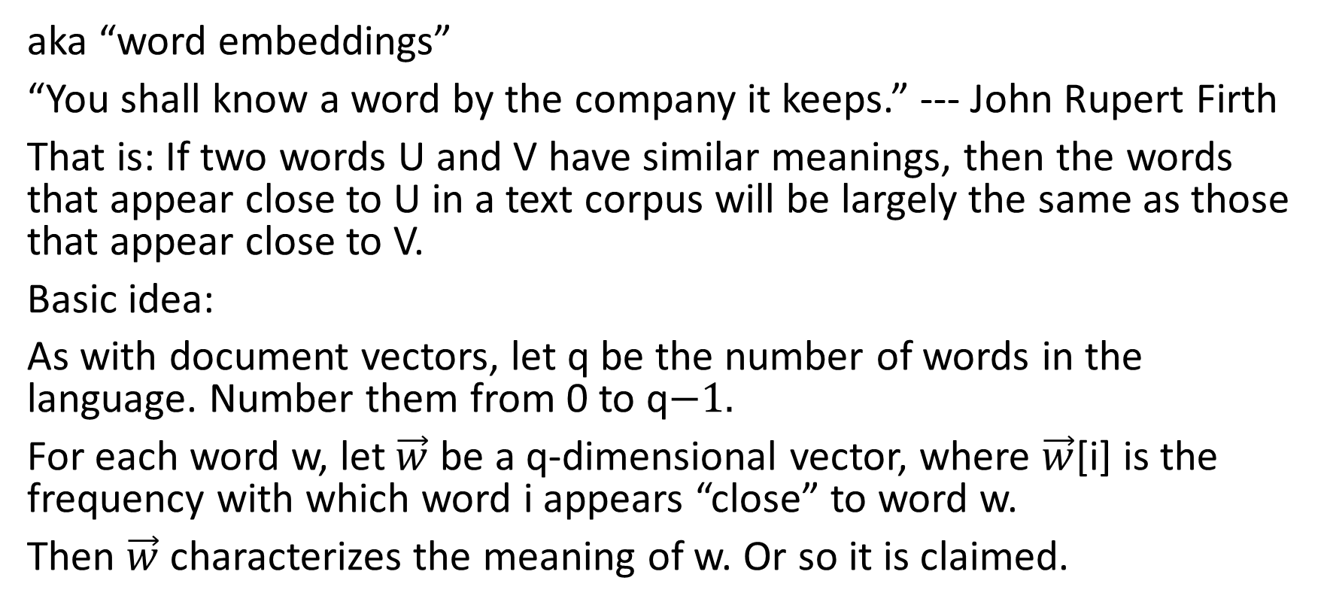
Word vectors: Co-occurence statistics
aka “word embeddings”
“You shall know a word by the company it keeps.” --- John Rupert Firth
That is: If two words U and V have similar meanings, then the words that appear close to U in a text corpus will be largely the same as those that appear close to V.
Basic idea:
As with document vectors, let q be the number of words in the language. Number them from 0 to q−1.
For each word w, let $\vec{w}$ be a q-dimensional vector, where $\vec{w}$[i] is the frequency with which word i appears “close” to word w.
Then $\vec{w}$ characterizes the meaning of w. Or so it is claimed.

Slide 13
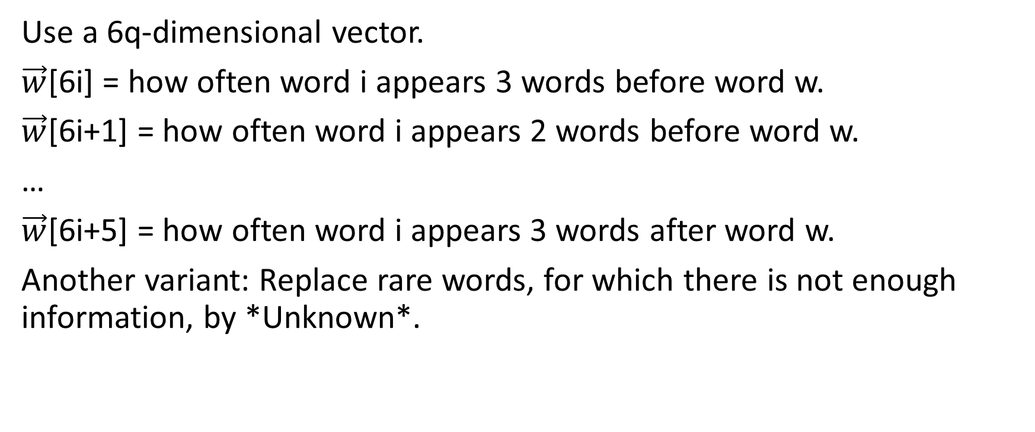
More sophisticated version incorporating positional information
Use a 6q-dimensional vector.
$\vec{w}$[6i] = how often word i appears 3 words before word w.
$\vec{w}$[6i+1] = how often word i appears 2 words before word w.
…
$\vec{w}$[6i+5] = how often word i appears 3 words after word w.
Another variant: Replace rare words, for which there is not enough information, by *Unknown*.

Slide 14
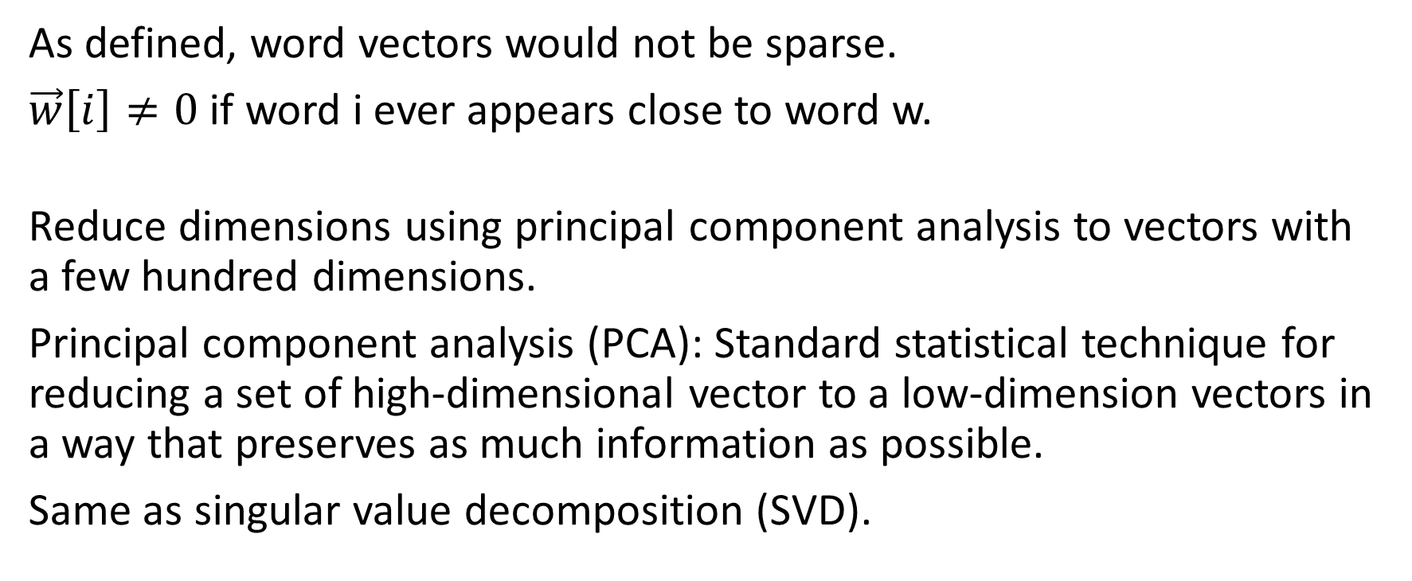
Dimensionality reduction
As defined, word vectors would not be sparse.
$\vec{w}\left[i\right]≠0$ if word i ever appears close to word w.
Reduce dimensions using principal component analysis to vectors with a few hundred dimensions.
Principal component analysis (PCA): Standard statistical technique for reducing a set of high-dimensional vector to a low-dimension vectors in a way that preserves as much information as possible.
Same as singular value decomposition (SVD).

Slide 15
Latent semantic analysis
Given: A matrix of number of occurrences of word in documents.
M[t,d] = number (or weight) of occurrences of word w in document d
Fix: dimension q (100s)
Compute simultaneously:
q-dimensional document vectors for each document
q-dimensional term vectors for each term.

Slide 16
Latent semantic analysis
By computing the word and document vectors together, you get feedback from one to another.
E.g. since “doctor” and “physician” occur in similar documents, they will get word vectors that are close together.
That causes documents containing “doctor” and documents containing “physician” to be placed close together.
That further improves the term vectors.
(Not actually an iterative process; just an outcome of the vector algebra.)

Slide 17
Obvious problem: polysemy (lexical ambiguity)
If a word has multiple meanings and only one vector, then that vector ends up being at sort of an “average” of the different meanings.
More sophisticated word vectors take into account the context.

Slide 18
What can you do with word vectors?
Compute similarity.
Apply vector techniques to words.
Replace words with vectors in any word-based algorithm. E.g. as input to deep learning systems

Slide 19
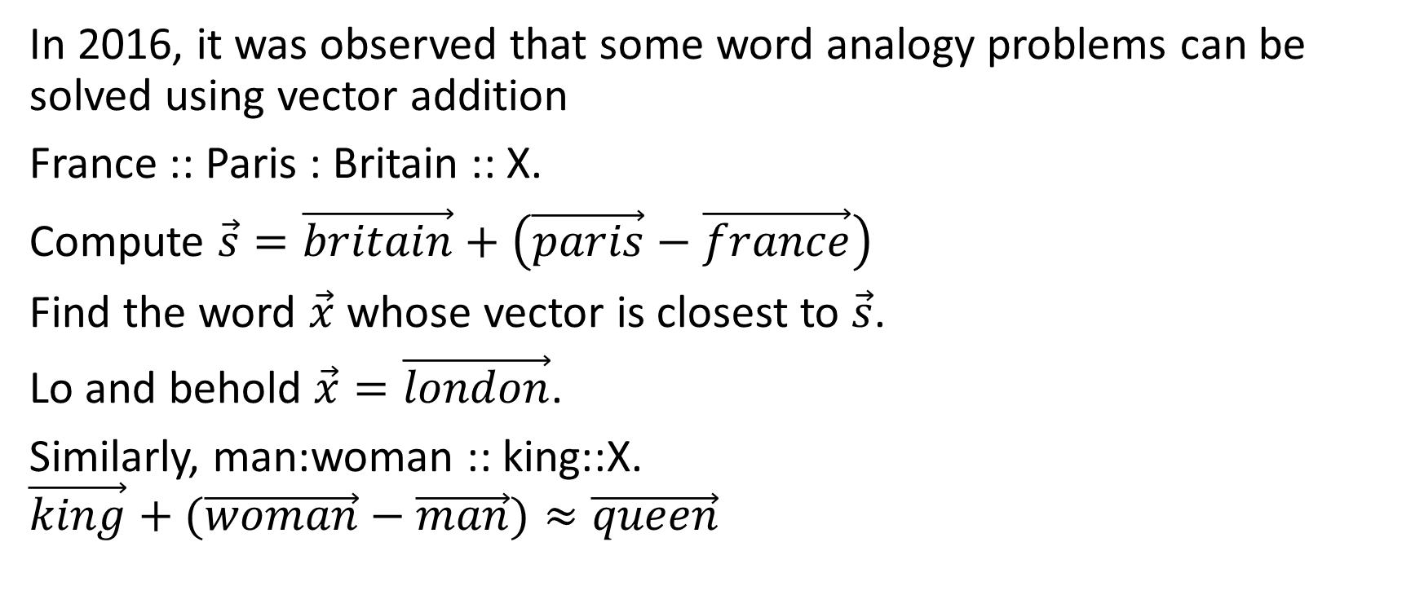
Analogy as vector addition
In 2016, it was observed that some word analogy problems can be solved using vector addition
France :: Paris : Britain :: X.
Compute $\vec{s}=\vec{britain}+\left(\vec{paris}−\vec{france}\right)$
Find the word $\vec{x}$ whose vector is closest to $\vec{s}$.
Lo and behold $\vec{x}=\vec{london}$.
Similarly, man:woman :: king::X.
$$\vec{king}+(\vec{woman}−\vec{man})≈\vec{queen}$$

Slide 20
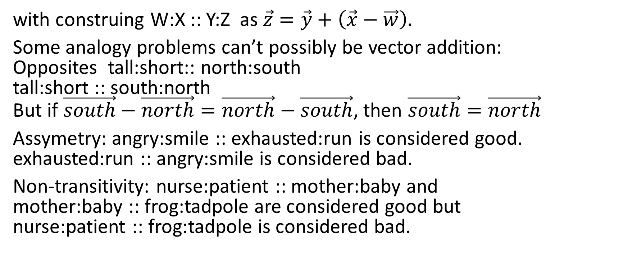
But there are problems
with construing W:X :: Y:Z as $\vec{z}=\vec{y}+\left(\vec{x}−\vec{w}\right).$
Some analogy problems can’t possibly be vector addition: Opposites tall:short:: north:south tall:short :: south:north But if $\vec{south}−\vec{north}=\vec{north}−\vec{south}$, then $\vec{south}=\vec{north}$
Assymetry: angry:smile :: exhausted:run is considered good. exhausted:run :: angry:smile is considered bad.
Non-transitivity: nurse:patient :: mother:baby and mother:baby :: frog:tadpole are considered good but nurse:patient :: frog:tadpole is considered bad.

Slide 21
Unacceptable stereotypes
man:woman :: doctor:X
gave the answer X=nurse.
Other examples.
Failures of similarity measure: “ethical” is closer to “unethical” than to “good”

Slide 22
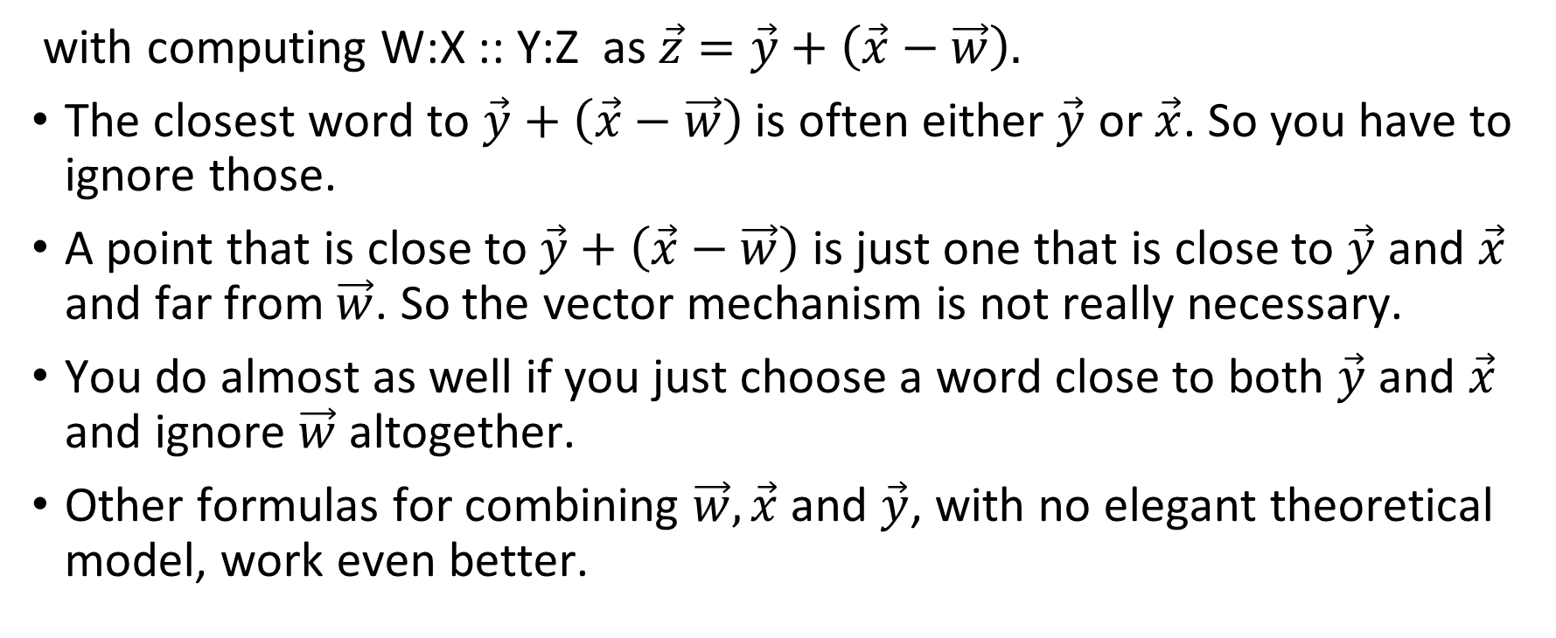
Technical issues:
with computing W:X :: Y:Z as $\vec{z}=\vec{y}+\left(\vec{x}−\vec{w}\right).$
The closest word to $\vec{y}+\left(\vec{x}−\vec{w}\right)$ is often either $\vec{y}$ or $\vec{x}$. So you have to ignore those.
A point that is close to $\vec{y}+\left(\vec{x}−\vec{w}\right)$ is just one that is close to $\vec{y}$ and $\vec{x}$ and far from $\vec{w}$. So the vector mechanism is not really necessary.
You do almost as well if you just choose a word close to both $\vec{y}$ and $\vec{x}$ and ignore $\vec{w}$ altogether.
Other formulas for combining $\vec{w}, \vec{x}$ and $\vec{y}$, with no elegant theoretical model, work even better.

Slide 23
Limits of word embeddings as theory of meaning
Throws away connection to real world. E.g. “London” means a particular place. “rabbit” means a particular kind of creature. “above” means a particular spatial relation.
Throws away logical structure. E.g. “sister” means “female child of the same parents”.
Throws away connection to circumstances of text/utterance. E.g. the date of utterance or writing.
AFAIK, throws away morphology.
Can they be used in a compositional semantics?

